Slide 1
Unit 3 IoT in Cloud Architecture

Slide 2
IoT in Cloud Architecture
The cloud components of IoT architecture are positioned within a three-tier architecture pattern comprising edge, platform and enterprise tiers.
The edge-tier includes Proximity Networks and Public Networks where data is collected from devices and transmitted to devices.
Data flows through the IoT gateway or optionally directly from/to the device then through edge services into the cloud provider via IoT transformation and connectivity.
The Platform tier is the provider cloud, which receives processes and analyzes data flows from the edge tier and provides API Management and Visualization.
It provides the capability to initiate control commands from the enterprise network to the public network as well.
The Enterprise tier is represented by the Enterprise Network comprised of Enterprise Data, Enterprise User Directory, and Enterprise Applications.
The data flow to and from the enterprise network takes place via a Transformation and Connectivity component.
The data collected from structured and non- structured data sources, including real-time data from stream computing, can be stored in the enterprise data.

Slide 3
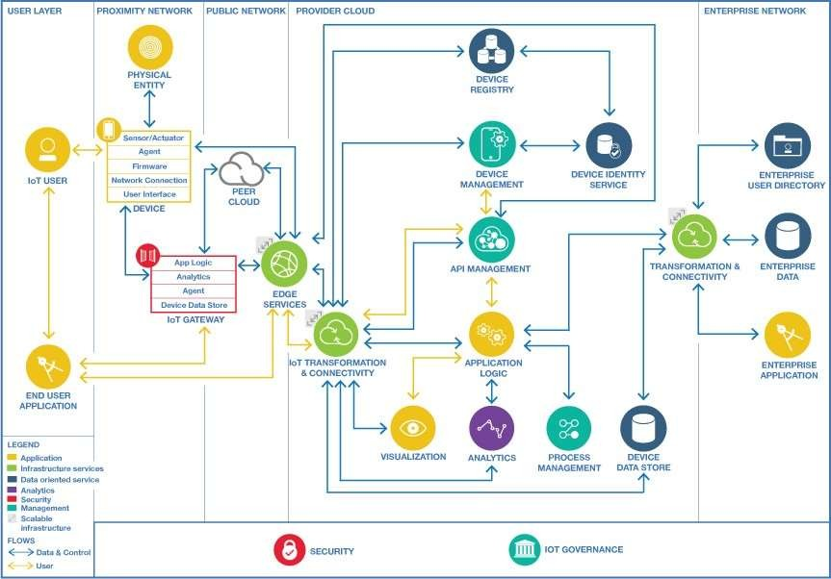
Cloud Components for IoT

Slide 4
The user layer is independent of any specific network domain. It may be in or outside any specific domain.
The proximity network domain has networking capabilities that typically extend the public network domain. The devices (including sensor/actuator, firmware and management agent) and the physical entity are part of the proximity network domain. The devices communicate for both data flow and control flow either via an IoT Gateway and edge services or directly over the public network via edge services.
The public network and enterprise network domains contain data sources that feed the entire architecture. Data sources include traditional systems of record from the enterprise as well as new sources from Internet of Things (IoT). The public network includes communication with peer clouds.
The provider cloud captures data from devices, peer cloud services and other data sources (for example Weather services). It can use integration technologies or stream processing to transform, filter and analyze this data in real time and it can store the data into repositories where further analytics can be performed.
This processing, which can be augmented with the use of Cognitive and Predictive analytics, is used to generate Actionable Insights.
These insights are used by users and enterprise applications and can also be used to trigger actions to be performed by IoT Actuators.

Slide 5
User Layer
User Layer - contains IoT users and their end user applications
IoT User (people/system) - a person or alternatively an automated system that makes use of one or more end user applications to achieve some goal. The IoT User is one of the main beneficiaries of the IoT solution.
End User Application - domain specific or device specific application. The IoT user may use end user applications that run on smart phones, tablets, PCs or alternatively on specialized IoT devices including control panels.

Slide 6
Proximity Network
Proximity Network - contains the physical entities that are at the heart of the IoT system, along with the devices that interact with the physical entities and connect them to the IoT system.
Physical Entity - the physical entity is the real-world. This architecture distinguishes between the physical entities and the IT devices that sense them or act on them. For example, the thing can be the ocean and the device observing is it a water temperature thermometer.
Device - contains sensor(s) and/or actuator(s) plus a network connection that enables interaction with the wider IoT system. There are cases where the device is also the physical entity being monitored by the sensors
eg. an accelerometer inside a smart phone.

Slide 7
Proximity Network
Sensor/Actuator - senses and acts on physical entities. A sensor is a component that senses or measures certain characteristics of the real world and converts them into a digital representation. An actuator is a component that accepts a digital command to act on a physical entity in some way.
Agent - provides remote management capabilities for the device, supporting a device management protocol that can be used by the Device Management service or IoT management system.
Firmware - software that provides control, monitoring and data manipulation of engineered products and systems. The firmware contained in devices such as consumer electronics provides the low-level control program for the devices.
Network Connection - provides the connection from the device to the IoT system. This is often a local network that connects the device with an IoT gateway – low power and low range in many cases to reduce the power demands on the device.
User Interface - allows users to interact with applications, agents, sensors and actuators (optional – some devices have no user interface and all interaction takes place from remote applications over the network).

Slide 8
Proximity Network- IoT Gateway
IoT Gateway - acts as a means for connecting one or more devices to the public network (typically the Internet). It is commonly the case that devices have limited network connectivity – they may not be able to connect directly to the Internet.
This can be for a number of reasons, including the limitation of power on the device, which can restrict the device to using a low-power local network.
The local network enables the devices to communicate with a local IoT Gateway, which is then able to communicate with the public network. The IoT Gateway contains the following components.

Slide 9
IoT Gateway-Components
App Logic - provides domain specific or IoT solution specific logic that runs on the IoT Gateway.
For IoT systems that have Actuators which act on physical entities, a significant capability of the app logic is the provision of control logic which makes decisions on how the actuators should operate, given input from sensors and data of other kinds, either held locally or held centrally.
Analytics - provides Analytics capability locally rather than in the provider cloud.
Agent - allows management of the IoT Gateway itself and can also enable management of the attached devices by providing a connection to the provider cloud layer's Device Management service via the device management protocol.
Device Data Store - stores data locally. Devices may generate a large amount of data in real time it may need to be stored locally rather than being transmitted to a central location. Data in the device data store can be used by the application logic and analytics capability in the IoT Gateway.

Slide 10
Public network
Public Network - contains the wide area networks (typically the internet), peer cloud systems, the edge services.
Peer Cloud - a 3rd party cloud system that provides services to bring data and capabilities to the IoT platform. Peer clouds for IoT may contribute to the data in the IoT system and may also provide some of the capabilities defined in this IoT architecture. For example an IoT for Insurance solution may use services from partners, such as weather data.
Edge Services - services needed to allow data to flow safely from the internet into the provider cloud and into the enterprise. Edge services also support end user applications. Edge services include:
Domain Name System Server - resolves the URL for a particular web resource to the TCP- IP address of the system or service that can deliver that resource.
Content Delivery Networks (CDN) - support end user applications by providing geographically distributed systems of servers deployed to minimize the response time for serving resources to geographically distributed users, ensuring that content is highly available and provided to users with minimum latency. Which servers are engaged will depend on server proximity to the user, and where the content is stored or cached

Slide 11
Firewall - controls communication access to or from a system permitting only traffic meeting a set of policies to proceed and blocking any traffic that does not meet the policies. Firewalls can be implemented as separate dedicated hardware, or as a component in other networking hardware such as a load-balancer or router or as integral software to an operating system.
Load Balancers - provides distribution of network or application traffic across many resources (such as computers, processors, storage, or network links) to maximize throughput, minimize response time, increase capacity and increase reliability of applications. Load balancers can balance loads locally and globally. Load balancers should be highly available without a single point of failure.

Slide 12
Provider Cloud
Provider Cloud - provides core IoT applications and associated services including storage of device data; analytics; process management for the IoT system; create visualizations of data. Also hosts components for device management including a device registry.
A cloud computing environment provides scalability and elasticity to cope with varying data volume, velocity and related processing requirements. Experimentation and iteration using different cloud service configurations is a good way to evolve the IoT system, without upfront capital investment.
IoT Transformation and Connectivity - enables secure connectivity to and from IoT devices. This component must be able to handle and perhaps transform high volumes of messages and quickly route them to the right components in the IoT solution. The Transformation and Connectivity component includes the following capabilities:

Slide 13
Secure Connectivity- provides the secured connectivity which authenticates and authorizes access to the provider cloud.
Scalable Messaging- provides messaging from and to IoT devices. Scalability of the messaging component is essential to support high data volume applications and applications with highly variable data rates, like weather.
Scalable Transformation- provides transformation of device IoT data before it gets to provider cloud layer, to provide a form more suitable for processing and analysis.
This may include decoding messages that are encrypted, translating a compressed formatted message, and/or normalizing messages from varying devices

Slide 14
Application Logic - The core application components, typically coordinating the handling of IoT device data, the execution of other services and supporting end user applications. An Event based programming model with trigger, action and rules is often a good way to write IoT application logic. Application logic can include workflow. Application logic may also include control logic, which determines how to use actuators to affect physical entities, for those IoT systems that have actuators.
Visualization - enables users to explore and interact with data from the data repositories, actionable insight applications, or enterprise applications. Visualization capabilities include End user UI, Admin UI & dashboard as sub components.
End User UI allows users to communicate and interact with Enterprise applications, analytics results, etc. This also includes internal or customer facing mobile user interfaces.
Admin UI- enables administrators to access metrics, operation data, and various logs. Dashboard - allows users to view various reports. Admin UI and Dashboard are internal facing user interfaces

Slide 15
Analytics - Analytics is the discovery and communication of meaningful patterns of information found in IoT data, to describe, to predict, and to improve business performance.
Process Management - activities of planning, developing, deploying and monitoring the performance of a business process. For IoT systems, real-time process management may provide significant benefits.
Device Data Store - stores data from the IoT devices so that the data can be integrated with processes and applications that are part of the IoT System. Devices may generate a large amount of data in real time calling for the Device Data Store to be elastic and scalable.
API Management - publishes catalogues and updates APIs in a wide variety of deployment environments. This enables developers and end users to rapidly assemble solutions through discovery and reuse of existing data, analytics and services.
Device Management - provides an efficient way to manage and connect devices securely and reliably to the cloud platform. Device management contains device provisioning, remote administration, software updating, remote control of devices, monitoring devices. Device management may communicate with management agents on devices using management protocols as well as communicate with management systems for the IoT solutions.

Slide 16
Device Registry - stores information about devices that the IoT system may read, communicate with, control, provision or manage. Devices may need to be registered before they can connect to and or be managed by the IoT system. IoT deployments may have a large number of devices therefore scalability of the registry is important.
Device Identity Service - ensures that devices are securely identified before being granted access to the IoT systems and applications. In the IoT systems, device identification can help address threats that arise from fake servers or fake devices.
Transformation and Connectivity - enables secure connections to enterprise systems and the ability to filter, aggregate, or modify data or its format as it moves between cloud and
IoT systems components and enterprise systems (typically systems of record). Within the IoT reference architecture the transformation and connectivity component sits between the cloud provider and enterprise network. However, in a hybrid cloud model these lines might become blurred. The Transformation and Connectivity component includes the following capabilities:

Slide 17
Enterprise Network
Enterprise Secure Connectivity -integrates with enterprise data security systems to authenticate and authorize access to enterprise systems.
Transformation -transforms data going to and from enterprise systems.
Enterprise Data Connectivity -enables provider cloud components to connect securely to enterprise data. Examples include VPN and gateway tunnels.
Enterprise Network - host a number of business specific enterprise applications that deliver critical business solutions along with supporting elements including enterprise data. Typically, enterprise applications have sources of data that are extracted and integrated with services provided by the cloud provider. Analysis is performed in the cloud computing environment, with output consumed by the enterprise applications.
Enterprise Data - includes metadata about the data as well as systems of record for enterprise applications. Enterprise data may flow directly to data integration or the data repositories providing a feedback loop in the analytical system for IoT. IoT systems may store raw, analyzed, or processed data in appropriate Enterprise Data elements.
Enterprise Data includes:
Enterprise User Directory - stores user information to support authentication, authorization, or profile data. The security services and edge services use this to control access to the enterprise network, enterprise services, or enterprise specific cloud provider services.

Slide 18
Enterprise Applications - Enterprise applications consume cloud provider data and analytics to produce results that address business goals and objectives. Enterprise applications can be updated from enterprise data or from IoT applications or they can provide input and content for enterprise data
Security and Privacy -Security and Privacy in IoT deployments must address both information technology (IT) security as well as operations technology (OT) security elements.
The level of attention to security and the topic areas to address varies depending upon the application environment, business pattern, and risk assessment
IoT systems must be designed, deployed, and managed such that they can always bring the system to a safe operating state, even when disconnected from communications with other systems that are part of the deployment.
Identity and Access Management-there must be strong identification of all participating entities – users, systems, applications, and, in the case of IoT, devices and the IoT gateways through which those devices communicate with the rest of the system. Device identity and management necessarily involves multiple entities, starting with chip and device manufacturers, including IoT platform providers, and also including enterprise users and operators of the devices.

Slide 19
Data Protection -Data in the device, in flight throughout the public network, provider cloud, and enterprise network, as well as at rest in a variety of locations and formats must be protected from inappropriate access and use.
Multiple methods can be utilized, and indeed, in many cases, multiple methods are applied simultaneously to provide different levels of protection of data against different types of threats or isolation from different entities supporting the system.

